Slide 1
CENTRAL EXPRESSWAY PROJECT -II
MEERIGAMA-KURUNEGALA (37+090-78+00)- 39.29 km
WITH AMBEPUSSA LINK

Slide 2

Section II (Package III)
Section II
MEErigama to Kurunegala -39.29km
CEP
Meerigama Kurunegala – 39.7 km
Ambepussa Link -9.3 km
(Two lane road)
Interchanges
MEErigama- North
Nakalagamuwa
Pothuhera System IC
Dambokka
Kurunegala
Section | Funding | Contractor | Consultant
2 | Local Banks | 4 Consortiums | One Consortium Consultants

Slide 3
PROJECT SUMMARY
No. of Lanes - 04
Lane width - 3.6m
Road Length - 39.29km
Project Duration - -4 Years (From 2016 Jan to Dec 2019 )
Project Cost –
Civil Works LKR 137.098 Billion( Excluding Taxes)
Construction Supervision LKR 2.243 Billion +US$ 5.861 Million
(excluding Taxes)
3. Land Acquisitions LKR 6.5 Billion

Slide 4
Details of structures
Type of Structure | Length | Nos | Description
Viaducts | 6820m
Underpass Bridges | 1065m | 4 Nos. | 4 Nos. Length 20m
Overpass Bridges |  | 7 Nos. | 4 Nos. Length 80m , 1 No. Length 100m, 1 No. Length 30m, 1 No. Length 155m
Underpass Box Structures |  | 22 Nos. | Provided 14 Nos. for 8.2m wide roads, 1 No. for 10m wide roads, 1 No. for 6m wide road, 3 Nos. for 4m wide roads and 3 Nos. for 3m wide roads

Slide 5
Progress of
Activities

Slide 6
Project Activities
1. Land Acquisitions & Resettlement Process
2. Project Procurement completed
3.Project Implementation Commenced

Slide 7
1.Land Acquisitions & Resettlement Process

Slide 8
NUMBER OF LOTS AND AREA TO BE ACQUIRED (PRIVATE LANDS)
DS DIVISION | LANDS TO BE ACQUIRED (PRIVATE)
 | No of Lots To be Acquired/ Completed | Area in Ha
Kurunegala | 890 /51 | 50.0242
Narammala | 1026 | 78.7162
Weerambugedara | 358 | 31.2942
Polgahawela | 560 | 39.4833
Allawwa | 293 | 51.1862
Meerigama | 513/49 | 69.0322
TOTAL | 3640/100 | 319.7363

Slide 9
2.Project Procurement

Slide 10
Central Expressway Project Section II
Meerigama to Kurunegala
Procurement of Contractors -Time Schedule
NO | *Activity | *Proposed Time (Days) | *Date of Commencement | *Date of Completion
1 | Appointment Of CANC & PC | 10 | 20/06/2016 | 30/06/2016
2 | Preparation of Bidding Document | 01 month | 20/6/2016 | 21/07/2016
4 | Scrutinizing the Budding Document by PC | 14 | 22/07/2016 | 06/08/2016
5 | Approval for the Budding Document By CANC | 7 | 08/08/2016 | 15/08/2016 04/08/2016
6 | Issue of Budding Documents and Closing of Bids Per-Bid meeting, Site visits an give clarification if any, issue addenda if any | 28 | 05/08/2016 | 19/09/2016
7 | Evaluation of Bids by PC and submission PC report to CANC | 14 | 20/09/2016 | 30/09/2016
8 | Negotiations by CANC | 7 | 03/10/2016 | 7/10/2016
9 | Obtain CANC determination for award | 7 | 10/10/2016 | 14/10/2016
10 | Obtain approval of the Cabinet of Ministers for the Award | 10 | 17/10/2016 | 21/10/2016
12 | Issue of Letter of Acceptance | 7 | 24/10/2016 | 17/11/2016
13 | Signing of Contract | 2 | 30/10/2016 | 16/12/2016
COMPLETED

Slide 11
Consultant Procurement Schedule
NO | *Activity | *Proposed Time | *Date of Commencement | *Date of Completion
1 | Appointment Of CACPC | 1 week | 20/06/2016 | 30/06/2016
2 | Preparation of RFP Document | 2 weeks | 4/7/2016 | 15/07/2016
3 | Scrutinizing the RFP Document by TEC | 1 week | 18/07/2016 | 22/07/2016
4 | Approval for the RFP Document By CACPC | 1 week | 25/07/2016 | 04/8/2016
5 | Issue of RFP Documents an give clarification if any, issue addenda if any Closing RFP and Receiving RFP | 28 | 5/08/2016 | 06/09/2016
6 | Evaluation of RFP by TEC and submission PC report to CACPC | 5 weeks | 7/09/2016 | 14/10/2016
7 | Negotiations by CACPC | 1 week | 17/10/2016 | 21/10/2016
8 | Obtain CACPC determination for award | 1week | 24/10/2016 | 28/10/2016
9 | Obtain approval of the Cabinet of Ministers for the Award | 1 week | 31/10/2016 | 4/11/2016
10 | Issue of Letter of Acceptance | 1 week | 7/11/2016 | 28/11/2016
11 | Signing of Contract | 1week | 15/11/2016 | 30/12/2016
COMPLETED

Slide 12
Package Summary
PACKAGE - A
(From Meerigama To Riloluwa)
(From 37+090 To 46+800km)
Total Length 9.71km
Accepted Contract Amount – LKR 34.149
Contractor – ICC / ACCESS /NAWALOKA & KDESH Consortium

Slide 13
Package Summary
PACKAGE B
(From Riloluwa To Rangallepola)
(From 46+800 To 57+000km)
Total Length 10.20km
Accepted Contract Amount – LKR 34.592
Contractor – Sierra & Olympus / Tudawa & CEC Joint Venture Consortium

Slide 14
Package Summary
PACKAGE C
(From Rangallepola To Hiripitiwala & Dewatagedara To Maditiyawala)
(From 57+000 To 62+330km & 63+950 To 69+500km)
Total Length 10.88km
Accepted Contract Amount – LKR 32.084
Contractor – KDAW / NEM / E&C Consortium

Slide 15
Package Summary
PACKAGE D
(From Maditiyawala To Kurunegala)
(From 69+500 To 78+000km)
Total Length 8.50km
Accepted Contract Amount – LKR 36.271
Contractor – MAGA - CML / VVK-HOVAEL Consortium

Slide 16
3.Project Implementation

Slide 17
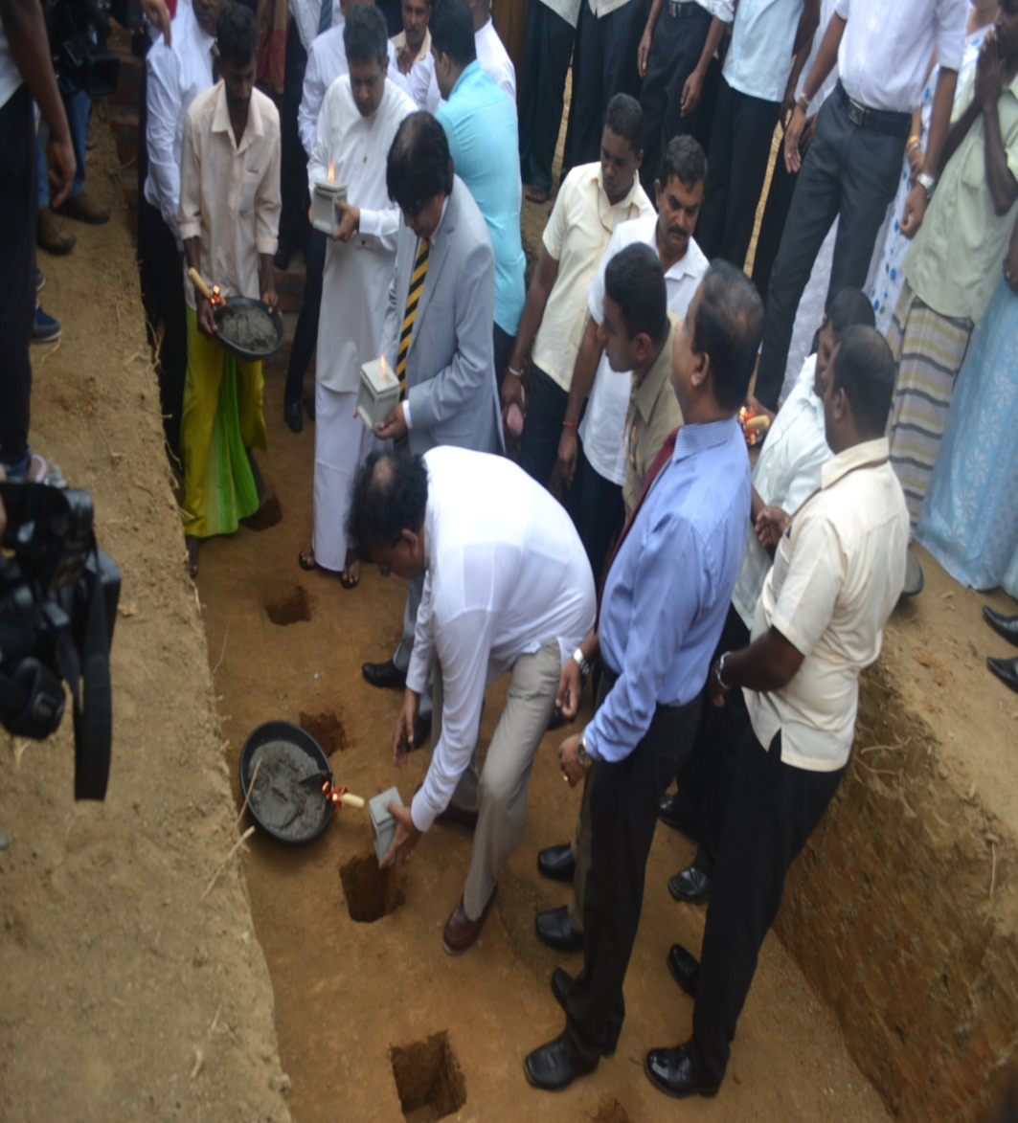
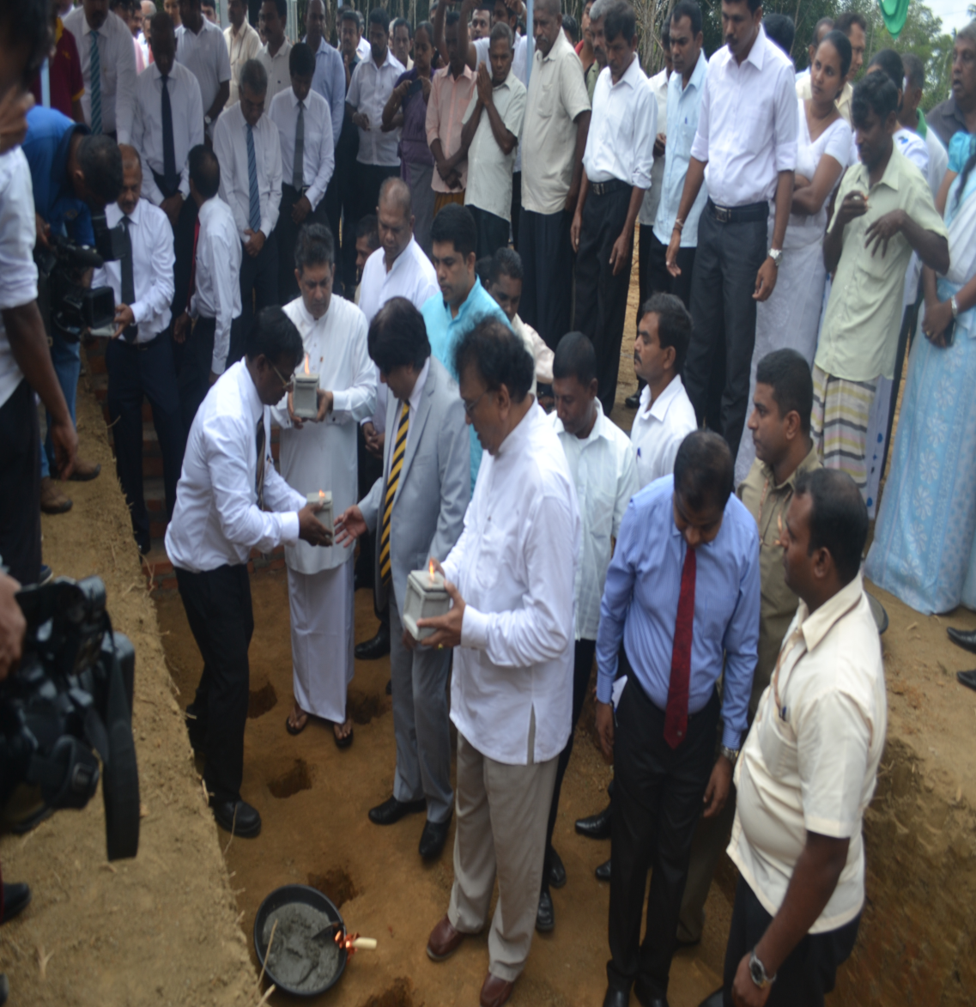
Central Expressway Project -2
INAGUARATION CEREMONEY HELD AT GIRIULLA ON- 6/10/2016

Slide 18
1. ACTION PLAN

Slide 19
Cumulative Progress
AS AT 25/01/2017
No |  | STATUS | Physical Progress
01 | Feasibility Studies , EIA study, Preliminary Design , Investigations & Resettlement Action Plan (RAP) | Completed | 100%
02 | Land Acquisition & Resettlement Program me | Progress | 70%
03 | Procure ment of Consultants (Construction Supervision) | Completed | 100%
04 | Procurement of 4 numbers of Civil Contractors | Completed | 100%
05 | Civil Construction Works | Works commenced Mobilization of Contractors and Consultants in progress | Commenced

Slide 20
ACTIVITIES DURUNG THE YEAR 2017
No |  | STATUS | Expected Progress
01 | Land Acquisition & Resettlement Program me | Progress | 100%
02 | Civil Construction Works | Works commenced Mobilization of Contractors and Consultants in progress | 30%

Slide 21
Issues and Challenges
Project Priority
Land Acquisition
Funding Arrangements.
Implementation
    Extraction and Deposit sites Approvals
    Approval of Quarries
    Environmental Clearances
    Other local authorities approvals

Slide 22
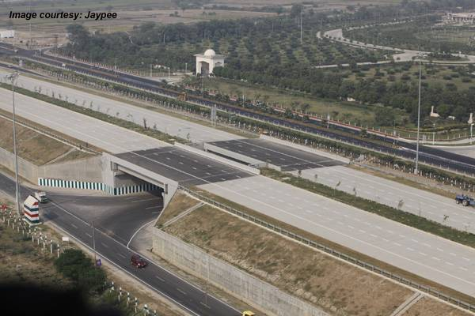
THANK YOU

